Slide 1
AI LAB:
12-MONTH ROADMAP
A Blueprint for Scalable, Cost-Effective Enterprise AI

Slide 2

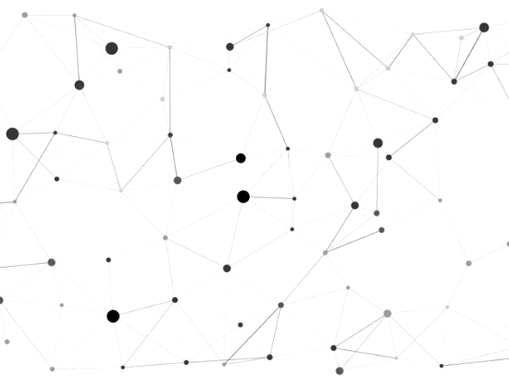
Vision — Cost-Effective AI Infrastructure
■
Democratized Research: Provide every employee an intuitive, friendly environment to research and innovate without technical barriers.
■
Zero Token Anxiety: Completely eradicate the fear of unpredictable, skyrocketing public API costs during experimentation.
■
Cost-Optimized Setup: Require minimal upfront investment by leveraging strategic hardware, controlling our operational footprint.
■
Limitless Exploration: Foster a dynamic culture where trial and error is encouraged, not penalized by a billing meter.

Slide 3






Architecture — Local GPU + Cloud Bursting
Local GPU Core
Cloud Bursting
Smart Gateway
Build the foundation on highly efficient, local hardware to seamlessly handle 80% of daily, steady-state AI research traffic at zero marginal cost.
Intelligently route overflow traffic or extremely complex model requests to public cloud environments only when strictly necessary, optimizing spend.
Deploy an intelligent routing layer that sits directly between the user and the models, automatically choosing the most efficient processing path.

Slide 4

MVP 1 | Months 1–3 — Foundation & Shared GPUs
Core Objectives
Business Value
■
Procure and stand up the initial physical hardware (local GPU instances).
■
Demonstrate immediate AI capabilities without triggering cloud billing.
■
Deploy open-source, high-efficiency base models (e.g., Llama, Mistral).
■
Establish a secure, private sandbox for employees to experiment safely.
■
Implement a user-friendly Chat UI for 15-20 early internal adopters.
■
Validate the hardware-to-user ratio and establish baseline performance.

Slide 5

MVP 1 — Technical Architecture
The Local Engine
Hardware: Utilizing repurposed existing servers or a dedicated high-tier workstation to form the core compute layer.
Serving: Implementing highly optimized inference frameworks for maximum local throughput with minimal latency.
UI: A centralized, user-friendly web portal ensures no technical expertise is required to begin researching.

Slide 6
MVP 2 | Months 4–6 — Routing & Bursting
Intelligent Scaling
Enhanced Capabilities
■
Introduce a smart routing gateway to manage all incoming prompts.
■
Integrate Private RAG so users can securely chat with internal documents.
■
Establish strict rules: standard queries stay local; heavy queries burst to cloud.
■
Expand the pilot user base to wider departments based on early success.
■
Monitor usage patterns to ensure cloud spend remains strictly capped.
■
Refine the user experience based on direct feedback from adopters.

Slide 7

MVP 2 — Intelligent Request Flow
■
User Prompt: An employee submits a research query via the friendly, unified lab interface.
■
The Gateway: Our smart routing layer analyzes the request's complexity and current local server load.
■
Local Priority: By default, the query is processed on local GPUs, incurring zero marginal cost.
■
Cloud Fallback: If local servers are at maximum capacity, the request securely "bursts" to the cloud.

Slide 8






MVP 3 | Months 7–9 — AIaaS & Multi-Tenancy
Multi-Tenancy
AI as a Service
Analytics Dashboard
Isolate environments so different departments (HR, Engineering, Sales) have dedicated, secure workspaces tailored to their data.
Expose internal APIs, empowering developers to easily integrate local AI features directly into proprietary company software.
Track precise usage metrics, calculate exact cost-savings vs. cloud, and present crystal-clear ROI data to leadership.

Slide 9

MVP 3 — Developer Platform
Empowering Builders
Platform Shift: Transitioning from a simple chat interface to a robust API platform tailored for internal engineers.
Automation: Developers can programmatically access local models to automate workflows, summarize tickets, and write code.
Cost-Free Testing: Local innovation cycles allow teams to run thousands of API calls during development without cloud charges.

Slide 10
MVP 4 | Months 10–12 — Specialized Workloads
Advanced Tuning
Enterprise Rollout
■
Implement Parameter-Efficient Fine-Tuning (LoRA) for accuracy.
■
Open the Innovation Lab to the entire organization for full access.
■
Train open models specifically on our proprietary data and jargon.
■
Host an internal AI Hackathon to drive adoption and new use cases.
■
Deploy highly specialized "Agent" models for specific business tasks.
■
Finalize the scalable architecture blueprint for Year 2 expansion.

Slide 11



12-Month Timeline — Month 1 → Month 12
MVP 2 (M 4-6)
MVP 4 (M 10-12)
Dynamic Routing. Request flow and RAG integration.
Scale & Rollout. Fine-tuning and full enterprise access.
MVP 1 (M 1-3)
MVP 3 (M 7-9)
Foundation & GPUs. Local models and UI deployed.
AIaaS & Tenants. Dev Platform and secure silos.

